Slide 1
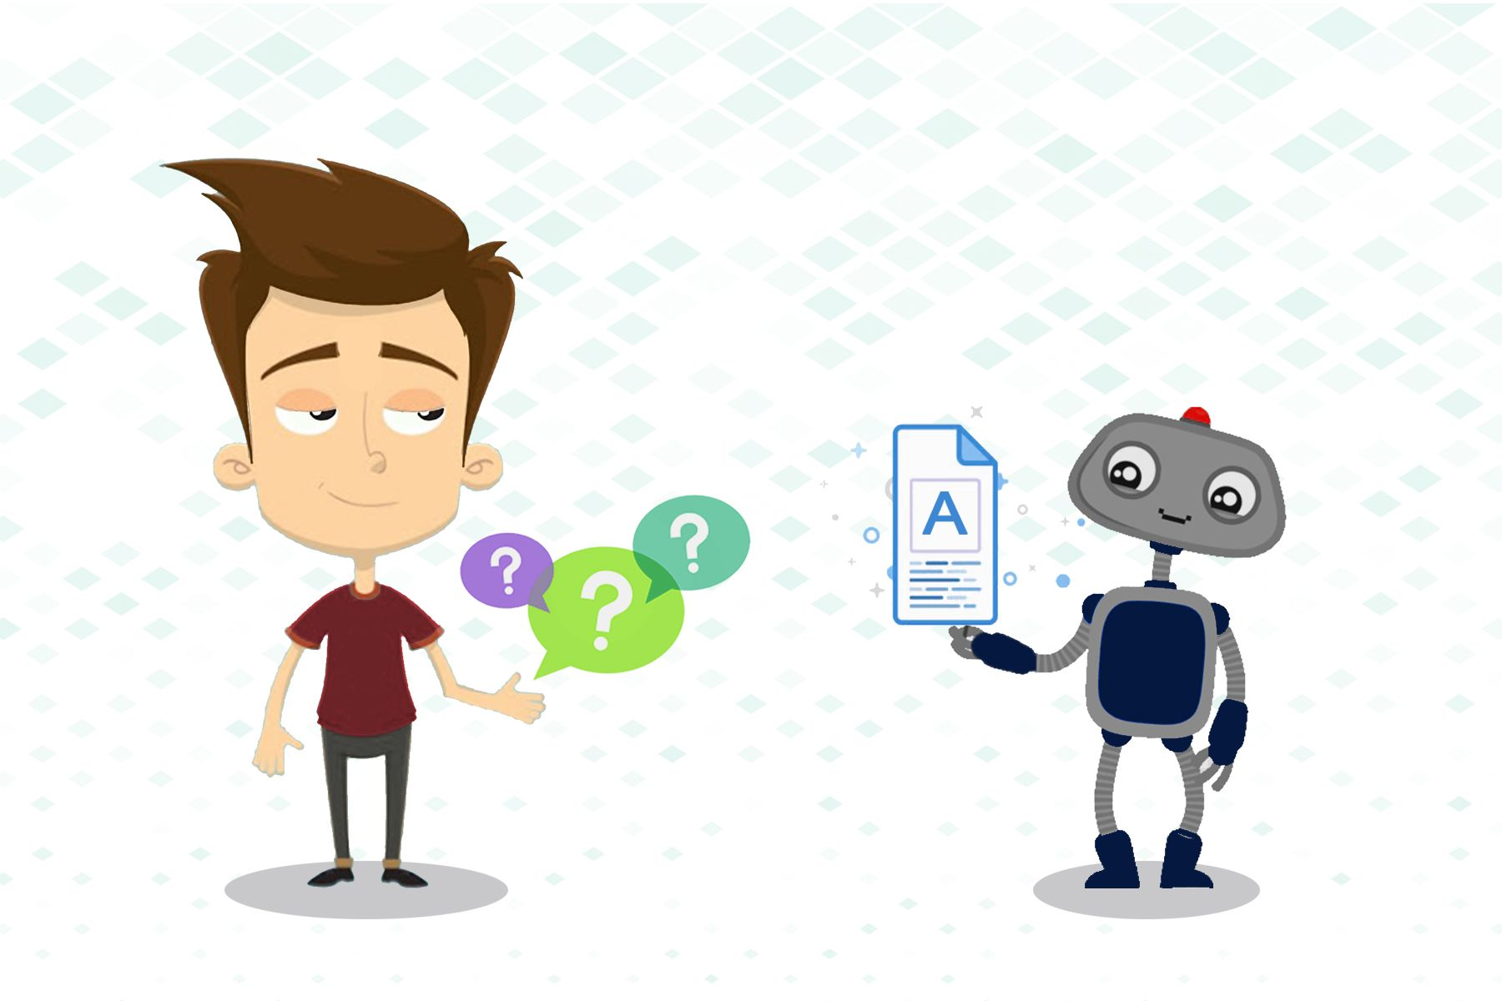
Question Answering
Notes:
Lecture 10 - Question Answering

Slide 2

What is Question Answering?
Question Answering models are able to retrieve the answer to a question from a given text. This is useful for searching for an answer in a document. Depending on the model used, the answer can be directly extracted from text or generated from scratch.
Notes:
What is Question Answering?
Question answering is a critical NLP problem and a long-standing artificial intelligence milestone. QA systems allow a user to express a question in natural language and get an immediate and brief response. QA systems are now found in search engines and phone conversational interfaces, and they’re fairly good at answering simple snippets of information. On more hard questions, however, these normally only go as far as returning a list of snippets that we, the users, must then browse through to find the answer to our question.

Slide 3
Question Answering
One of the oldest NLP tasks (punched card systems in 1961)
Simmons, Klein, McConlogue. 1964. Indexing and Dependency Logic for Answering English Questions. American Documentation 15:30, 196-204
Notes:
Example question and potentials answers for the question What do warms eat?

Slide 4
Question Answering: IBM’s Watson
Won Jeopardy on February 16, 2011!
WILLIAM WILKINSON’S
“AN ACCOUNT OF THE PRINCIPALITIES OF WALLACHIA AND MOLDOVIA”
INSPIRED THIS AUTHOR’S
MOST FAMOUS NOVEL
Bram Stoker
Notes:
Question Answering: IBM’s Watson Example
The computer system was initially developed to answer questions on the quiz show Jeopardy! and in 2011, the Watson computer system competed on Jeopardy!

Slide 5
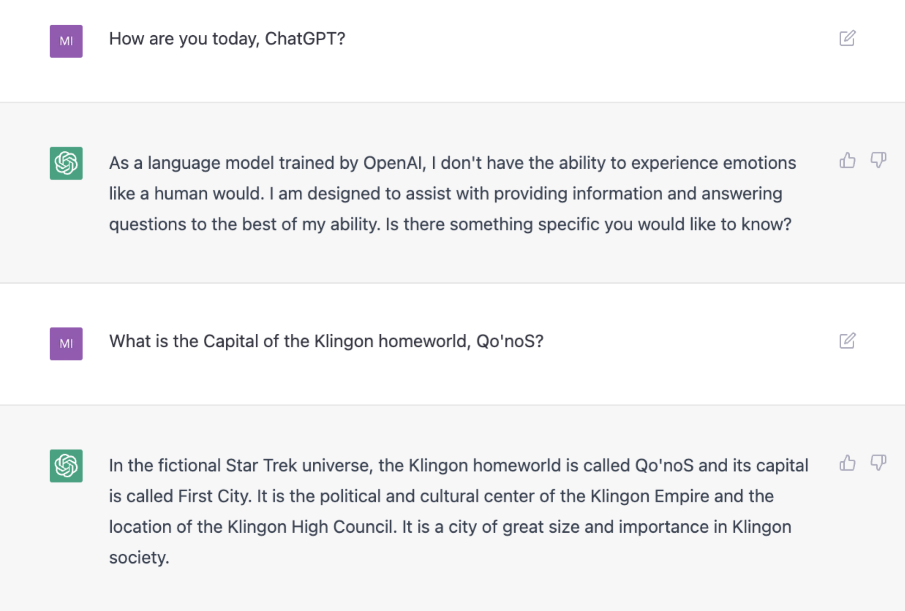
Notes:
Example of simple question answering which we are using in our day to day life nowadays.

Slide 6
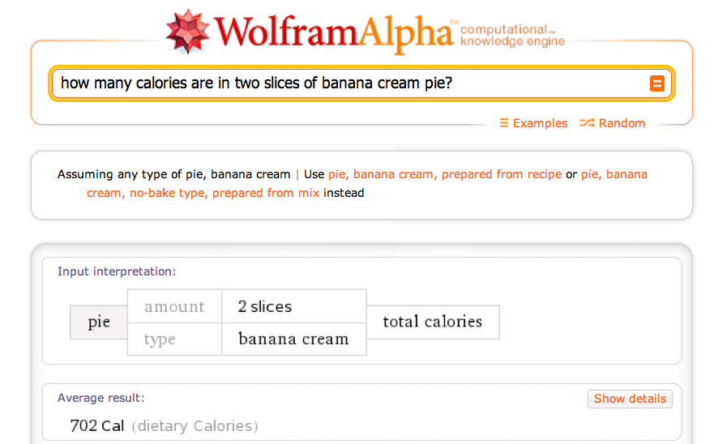
Wolfram Alpha

Slide 7
WHY?
“Search engines do not speak your language. They make you speak their language; a language that's strange, confusing, and includes words that no one is entirely sure of their meaning.”
QA engines attempt to let you ask your question the way you'd normally ask it .
Inexperienced users
Document=Answer?
Notes:
The point of a QA system is to understand the question and give an answer that is correct and helpful.
QA systems can be based on various techniques, including information retrieval, knowledge-based, generative, and rule-based approaches. Each method has its strengths and weaknesses, and the choice of method depends on the project’s specific needs.
QA systems can be used in many places, like customer service, search engines, healthcare, education, finance, e-commerce, voice assistants, chatbots, and virtual assistants.

Slide 8
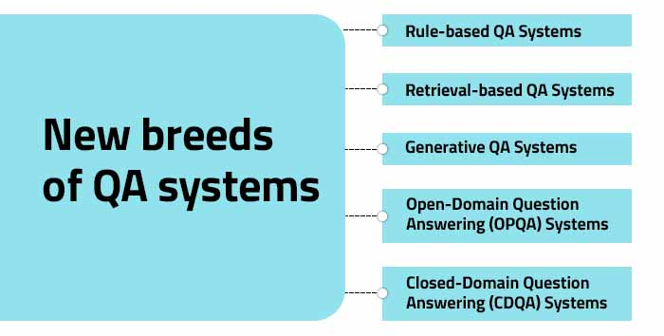
Types of Questions in Modern Systems
Notes:
Different types of Question Answering

Slide 9
Types of Questions in Modern Systems
Factoid questions
Who wrote “The Universal Declaration of Human Rights”?
How many calories are there in two slices of apple pie?
What is the average age of the onset of autism?
Where is Apple Computer based?
Complex (narrative) questions:
In children with an acute febrile illness, what is the efficacy of acetaminophen in reducing fever?
What do scholars think about Jefferson’s position on dealing with pirates?
Notes:
Question answering (QA) systems are designed to provide concise, relevant answers to questions posed by users in natural language. These systems come in various types, each suited to different kinds of tasks and data sources. Here are the main types of question answering systems:
Closed-domain QA: This type of QA system focuses on answering questions within a specific domain or subject area, such as medicine, law, or finance. They rely on domain-specific data and are often optimized to handle the jargon and intricacies of their focused areas.
Open-domain QA: Unlike closed-domain QA, open-domain systems attempt to answer questions on a wide range of topics without being restricted to a specific subject area. These systems typically require access to vast amounts of general knowledge and use the internet or large databases like Wikipedia to find answers.
Factoid QA: These systems answer questions that can be responded to with brief facts, such as specific names, dates, or places. For example, "What is the capital of France?" would be a typical factoid question.
Non-factoid QA: This category includes systems that handle more complex questions that require detailed, often explanatory answers. For example, "How does photosynthesis work?" would be a non-factoid question.

Slide 10
Extractive QA: The model extracts the answer from a context. The context here could be a provided text, a table or even HTML! This is usually solved with BERT-like models.
Open Generative QA: The model generates free text directly based on the context. You can learn more about the Text Generation task in its page.
Closed Generative QA: In this case, no context is provided. The answer is completely generated by a model.
Moreover, QA systems differ in where answers are taken from.
Open QA: The answer is taken from a context.
Closed QA: No context is provided and the answer is completely generated by a model.
Notes:
List-based QA: This type involves questions that require a list of items as an answer. For instance, "What are the ingredients in a margarita?" would prompt the system to return a list of components.
Definition QA: These systems are designed to provide definitions or explain concepts in response to queries. For example, a question like "What is quantum mechanics?" would elicit a concise explanation of the term.
Visual QA: This involves answering questions based on visual content, such as images or videos. For example, given a picture of a street scene, the system might be asked, "What types of vehicles are in the image?"
Conversational QA: These systems are designed to manage a series of questions and answers that build on each other, maintaining context over a conversation. They are often implemented in chatbots and virtual assistants.

Slide 11
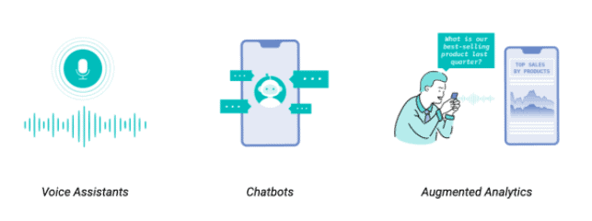
Notes:
QA systems can be used in many places, like customer service, search engines, healthcare, education, finance, e-commerce, voice assistants, chatbots, and virtual assistants.

Slide 12
Commercial systems: mainly factoid questions
Where is the Louvre Museum located? | In Paris, France
What’s the abbreviation for limited partnership? | L.P.
What are the names of Odin’s ravens? | Huginn and Muninn
What currency is used in China? | The yuan
What kind of nuts are used in marzipan? | almonds
What instrument does Max Roach play? | drums
What is the telephone number for Stanford University? | 650-723-2300
Notes:
Commercial question answering systems are typically optimized for factoid questions. These are questions that can be answered with concise, specific pieces of information, like a name, date, location, or other single piece of data. Factoid questions are prevalent in commercial settings because they align well with common user queries, such as those about business hours, product specifications, flight statuses, or currency conversions. The focus on factoid questions in commercial systems can be due to several factors:User Intent, Data Availability, Efficiency.

Slide 13
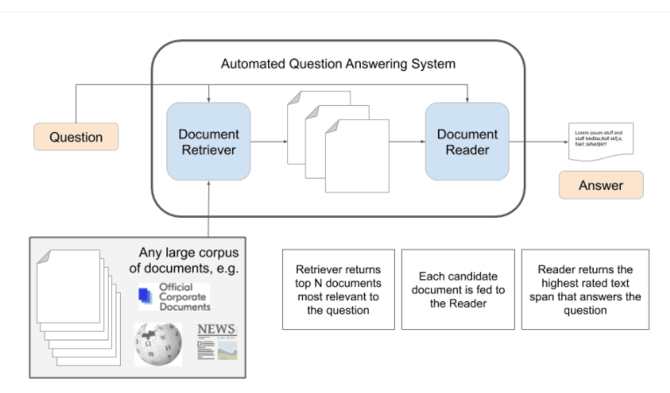
Question-Answering System
Notes:
This is a very adaptable design, and we’ve found that it can ask for a wide range of queries. Instead of having a list of options for each question, systems must choose the best answer from all potential spans in the passage, which means they must deal with a vast number of possibilities. Spans have the extra benefit of being simple to evaluate. The QA setting, depending on the span is extremely natural. Open-domain QA systems can typically discover the right papers that hold the solution to many user questions sent into search engines. The task is to discover the shortest fragment of text in the passage or document that answers the query, which is the ultimate phase of “answer extraction.”

Slide 14
Paradigms for QA
IR-based approaches
TREC; IBM Watson; Google
Knowledge-based and Hybrid approaches
IBM Watson; Apple Siri; Wolfram Alpha; True Knowledge Evi
Notes:
The paradigms of question answering (QA) refer to the underlying approaches and methodologies used to develop and implement QA systems. Here are some of the main paradigms:
Information Retrieval-Based QA: This is the most traditional paradigm where the system searches a large collection of documents to find the segment of text that is most likely to contain the answer. It is a retrieval task followed by answer extraction.
Knowledge-Based QA: This paradigm relies on a structured database or knowledge graph. The system translates the user's question into a query that can be executed against the database to retrieve answers.
Rule-Based QA: Systems under this paradigm use a set of hand-crafted linguistic rules to interpret the question and retrieve or generate an answer. It is less flexible and doesn't scale well but can be very accurate within its scope.
4.Machine Learning-Based QA: Leveraging statistical models, these systems learn to predict answers from a large corpus of question-answer pairs. This paradigm includes both supervised learning, where the system is trained on labeled data, and unsupervised learning, where the system tries to infer patterns from unlabeled data.

Slide 15
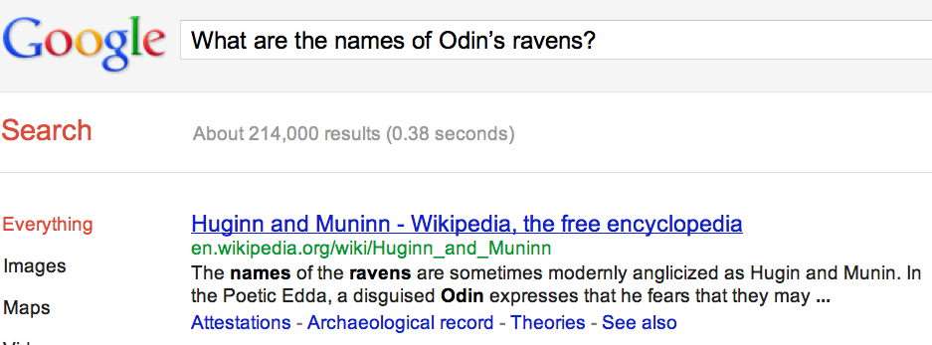
Many questions can already be answered by web search
a

Slide 16
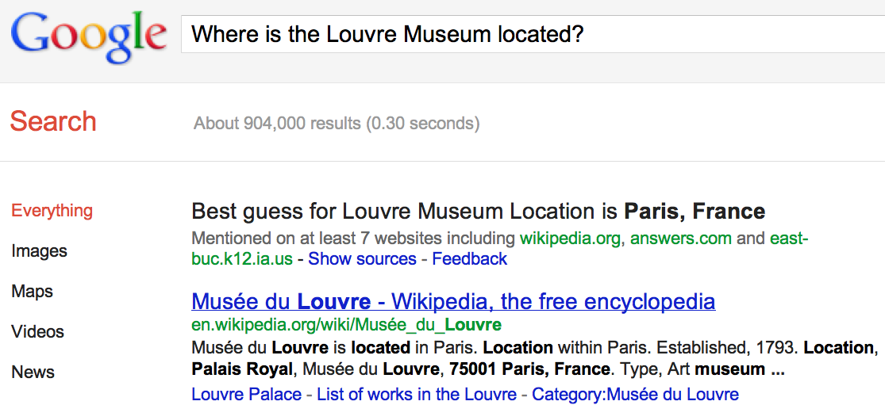
IR-based Question Answering
a
Notes:
Information Retrieval-Based QA: This is the most traditional paradigm where the system searches a large collection of documents to find the segment of text that is most likely to contain the answer. It is a retrieval task followed by answer extraction.

Slide 17
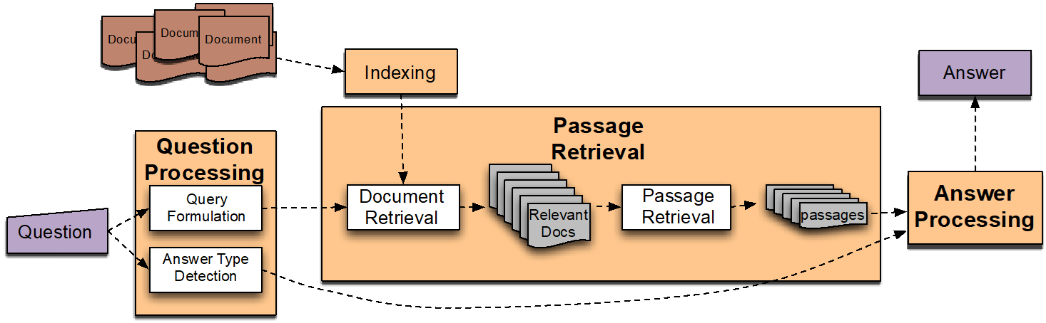
IR-based Factoid QA
QUESTION PROCESSING
Detect question type, answer type, focus, relations
Formulate queries to send to a search engine
PASSAGE RETRIEVAL
Retrieve ranked documents
Break into suitable passages and rerank
ANSWER PROCESSING
Extract candidate answers
Rank candidates
using evidence from the text and external sources
Notes:
In an Information Retrieval-based Factoid Question Answering (IR-based Factoid QA) system, the process generally involves three main stages:
Question Processing:
Detect Question Type: The system identifies the type of question being asked (e.g., "Who", "What", "When", "Where").
Answer Type: It determines the expected answer type, which can guide the search for the correct response (e.g., a person's name, a date, a location).
Focus: The focus is the specific subject or entity the question is about.
Relations: The system may also identify any relations implied by the question that can help refine the search (e.g., "CEO of" indicates a relation between a person and a company).
2.Passage Retrieval:
Retrieve Ranked Documents: The system uses the formulated queries to retrieve a list of documents that are likely to contain the answer.
Break into Suitable Passages: Documents are broken down into smaller passages that are more manageable and likely to contain precise answers.
Re-rank Passages: Passages are re-ranked based on their likelihood to contain the answer, using various signals such as the presence of answer type entities and the focus.

Slide 18
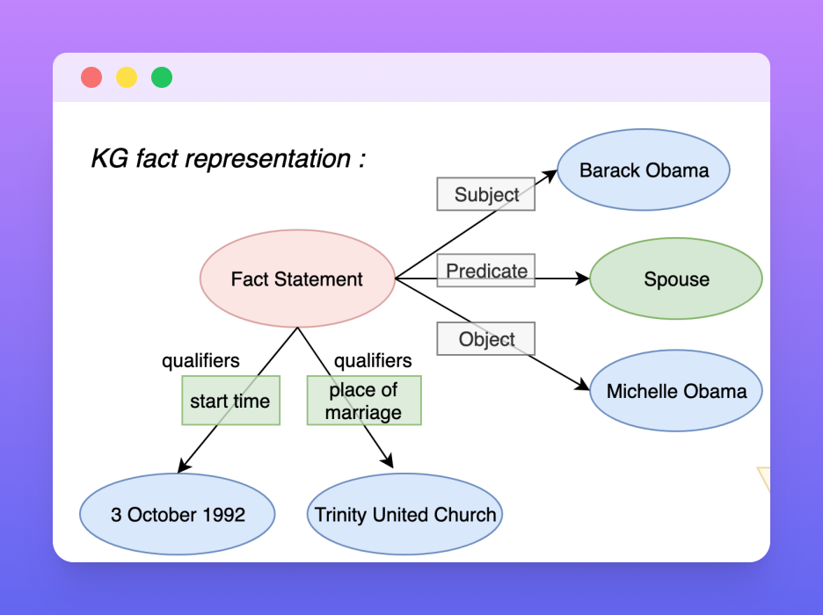
Knowledge-based approaches (Siri)
Build a semantic representation of the query
Times, dates, locations, entities, numeric quantities
Map from this semantics to query structured data or resources
Geospatial databases
Ontologies (Wikipedia infoboxes, dbPedia, WordNet, Yago)
Restaurant review sources and reservation services
Scientific databases
Notes:
3. Answer Processing:
Extract Candidate Answers: The system extracts potential answers from the passages.
Rank Candidates: Candidates are ranked based on several factors, including the frequency of appearance, the proximity to question terms, and contextual clues.
During this stage, the system might also:
Use Evidence from Text: It evaluates the text surrounding candidate answers for confirmation or additional clues.
External Sources: Sometimes, the system may refer to external sources like databases or knowledge bases to verify facts or add credibility to the candidate answers.

Slide 19
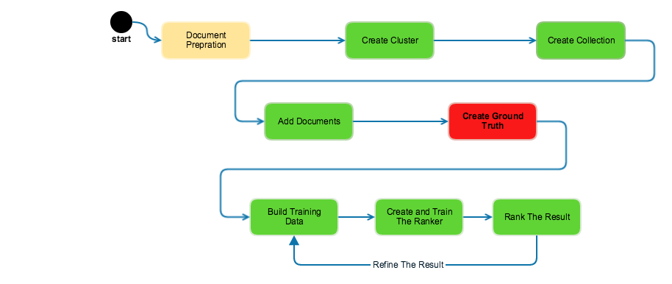
Hybrid approaches (IBM Watson)
Build a shallow semantic representation of the query
Generate answer candidates using IR methods
Augmented with ontologies and semi-structured data
Score each candidate using richer knowledge sources
Geospatial databases
Temporal reasoning
Taxonomical classification
Notes:
The IBM Watson Question Answering system is one of the most well-known examples of a hybrid approach to question answering. This hybrid model combines several different techniques and technologies to process and answer questions. Watson's architecture was built to be domain-independent, allowing it to be applied to various fields beyond game shows, including healthcare, finance, and customer service. Its hybrid approach, integrating techniques from information retrieval, natural language processing, machine learning, and knowledge representation, is a testament to the complexity and potential of modern AI systems in the realm of question answering.

Slide 20
Factoid Q/A
Notes:
This is a very adaptable design, and we’ve found that it can ask for a wide range of queries. Instead of having a list of options for each question, systems must choose the best answer from all potential spans in the passage, which means they must deal with a vast number of possibilities. Spans have the extra benefit of being simple to evaluate. The QA setting, depending on the span is extremely natural. Open-domain QA systems can typically discover the right papers that hold the solution to many user questions sent into search engines. The task is to discover the shortest fragment of text in the passage or document that answers the query, which is the ultimate phase of “answer extraction.”

Slide 21
Question Processing Things to extract from the question
Answer Type Detection
Decide the named entity type (person, place) of the answer
Query Formulation
Choose query keywords for the IR system
Question Type classification
Is this a definition question, a math question, a list question?
Focus Detection
Find the question words that are replaced by the answer
Relation Extraction
Find relations between entities in the question
Notes:
Different things to extract from the questions while processing the question.

Slide 22
Question Processing They’re the two states you could be reentering if you’re crossing Florida’s northern border
Answer Type: US state
Query: two states, border, Florida, north
Focus: the two states
Relations: borders(Florida, ?x, north)
Notes:
For the question "They’re the two states you could be reentering if you’re crossing Florida’s northern border," the system has dissected the question to understand and extract various components necessary to form an accurate search query:
Answer Type: The expected answer is a "US state," guiding the system to look for this type of entity in potential responses.
Query: The system formulates a query using key terms from the question: "two states," "border," "Florida," "north.
Focus: The focus of the question is identified as "the two states," which is the primary subject about which information is being sought.
Relations: The system also recognizes a relation that needs to be satisfied for a correct answer: the states must border Florida to the north. This is formalized in a structured query format as borders(Florida, ?x, north), indicating that the system is looking for entities ?x that have a "border" relation with "Florida" and are to the "north."

Slide 23
Answer Type Detection: Named Entities
Who founded Virgin Airlines?
PERSON
What Canadian city has the largest population?
CITY.
Notes:
Named Entity Recognition (NER) plays a crucial role in Question Answering (QA) systems. Here's how they work together:
NER for Filtering:
Question Analysis: The system analyzes the question to identify the expected answer type (e.g., person, location, date).
NER in Action: The NER module scans the passage for entities of that specific type.
Filtering Passages: Only passages containing relevant entities are considered for further processing. This filtering helps eliminate irrelevant text and improve efficiency.

Slide 24
Answer Type Taxonomy
6 coarse classes
ABBEVIATION, ENTITY, DESCRIPTION, HUMAN, LOCATION, NUMERIC
50 finer classes
LOCATION: city, country, mountain…
HUMAN: group, individual, title, description
ENTITY: animal, body, color, currency…
Xin Li, Dan Roth. 2002. Learning Question Classifiers. COLING'02

Slide 25
Part of Li & Roth’s Answer Type Taxonomy
Notes:
The image you sent depicts a part of Li and Roth's answer type taxonomy [1]. It categorizes answer types into different classes based on the information they provide. Here's a breakdown of the categories:
Entity: This category refers to answers that identify a specific person, location, or organization (e.g., Paris, France).
Abbreviation: This category includes answers that are shortened forms of something else (e.g., USA for United States of America).
Description: This category encompasses answers that provide a definition or characterization of something (e.g., the answer to the question "What is a mammal?" might be "warm-blooded animal with fur")
Date, Numeric, Location, Percent etc.

Slide 26
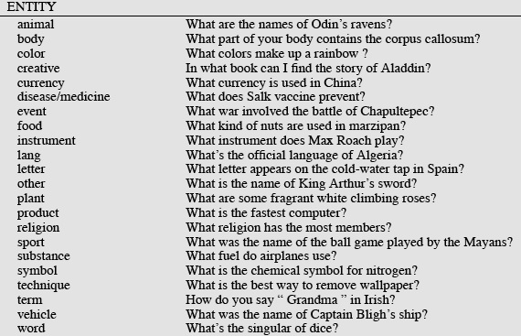
Answer Types
Notes:
Different type of answer entities

Slide 27
More Answer Types

Slide 28
Answer types in Jeopardy
Ferrucci et al. 2010. Building Watson: An Overview of the DeepQA Project. AI Magazine. Fall 2010. 59-79.
2500 answer types in 20,000 Jeopardy question sample
The most frequent 200 answer types cover < 50% of data
The 40 most frequent Jeopardy answer types
he, country, city, man, film, state, she, author, group, here, company, president, capital, star, novel, character, woman, river, island, king, song, part, series, sport, singer, actor, play, team, show, actress, animal, presidential, composer, musical, nation, book, title, leader, game
Notes:
Jeopardy! doesn't have a specific answer type taxonomy like Li and Roth's. The answers in Jeopardy! are presented as clues, and contestants phrase their responses as questions related to the clue. The answers themselves can encompass a wide range of categories like names, dates, places, titles, or even scientific concepts.

Slide 29
Answer Type Detection
Hand-written rules
Machine Learning
Hybrids
Notes:
Answer type detection (ATD) and written machine learning (WML) can be powerful tools when combined to create more robust and informative systems. Here's how they work together:ATD: Understanding the Question
Function: An ATD module analyzes a question to identify the expected answer type. This could be an entity (person, location), a description, a date, a number, etc. (refer back to Li and Roth's taxonomy for examples).
WML: Processing Textual Data
Techniques: WML encompasses various techniques like supervised learning, natural language processing (NLP), and deep learning.
Hybrid Advantages:
Improved Accuracy: By understanding the question type, the WML model can tailor its search and processing to find the most relevant and accurate answers.

Slide 30
Answer Type Detection
Regular expression-based rules can get some cases:
Who {is|was|are|were} PERSON
PERSON (YEAR – YEAR)
Other rules use the question headword:
(the headword of the first noun phrase after the wh-word)
Which city in China has the largest number of foreign financial companies?
What is the state flower of California?

Slide 31

Answer Type Detection
Most often, we treat the problem as machine learning classification
Define a taxonomy of question types
Annotate training data for each question type
Train classifiers for each question class using a rich set of features.
features include those hand-written rules!
Notes:
Define a Taxonomy of Question Types: This involves categorizing questions into a structured classification system. For example, questions might be grouped by whether they're asking for a definition, a fact, an opinion, etc.
Annotate Training Data for Each Question Type: Human annotators label a set of questions according to the previously defined taxonomy. This labeled data will be used to train machine learning models.
Train Classifiers for Each Question Class: With the annotated data, different classifiers are trained to recognize each type of question. These classifiers use various features extracted from the text of the questions.

Slide 32
Features for Answer Type Detection
Question words and phrases
Part-of-speech tags
Parse features (headwords)
Named Entities
Semantically related words
Notes:
Features Include Those Hand-Written Rules: In addition to statistical features that can be learned from the data, the system may also use hand-crafted rules. These could be based on linguistic insights, such as keyword spotting or pattern matching, to help the classifier distinguish between different types of questions.

Slide 33
Factoid Q/A

Slide 34
Keyword Selection Algorithm
Dan Moldovan, Sanda Harabagiu, Marius Paca, Rada Mihalcea, Richard Goodrum, Roxana Girju and Vasile Rus. 1999. Proceedings of TREC-8.
1. Select all non-stop words in quotations
2. Select all NNP words in recognized named entities
3. Select all complex nominals with their adjectival modifiers
4. Select all other complex nominals
5. Select all nouns with their adjectival modifiers
6. Select all other nouns
7. Select all verbs
8. Select all adverbs
9. Select the QFW word (skipped in all previous steps)
10. Select all other words
Notes:
Keyword selection algorithms are crucial in various applications, such as search engine optimization, text analysis, and information retrieval systems, including question answering (QA) systems. The core idea behind these algorithms is to identify the most relevant words or phrases (keywords) from a text that are indicative of the content's overall theme or are critical for retrieving relevant documents in response to a query.Term Frequency (TF)Inverse Document Frequency (IDF):TF-IDF (Term Frequency-Inverse Document Frequency):TextRank:Latent Semantic Analysis (LSA):

Slide 35
Choosing keywords from the query
Slide from Mihai Surdeanu
Who coined the term “cyberspace” in his novel “Neuromancer”?
1
1
4
4
7
cyberspace/1 Neuromancer/1 term/4 novel/4 coined/7
Notes:
Choosing the keywords from the above query example:

Slide 36
Passage Retrieval
Step 1: IR engine retrieves documents using query terms
Step 2: Segment the documents into shorter units
something like paragraphs
Step 3: Passage ranking
Use answer type to help rerank passages
Notes:
IR Engine retrieves documents using query terms: The IR system starts by taking user input in the form of a query and retrieving relevant documents from a dataset or the internet. Segment the documents into shorter units: Once the relevant documents are retrieved, they are broken down into smaller, more manageable pieces such as paragraphs or even sentences. Passage ranking: The segmented pieces of text are then ranked according to their relevance to the query. The IR system uses various signals to do this, one of which is the expected answer type. For instance, if the answer type is a 'person', the system will rank passages higher if they contain proper nouns. Additionally, the system may use other features such as the frequency of query terms in the passage, the proximity of the terms to each other, and any semantic similarities to the query terms.

Slide 37
Features for Passage Ranking
Either in rule-based classifiers or with supervised machine learning
Number of Named Entities of the right type in passage
Number of query words in passage
Number of question N-grams also in passage
Proximity of query keywords to each other in passage
Longest sequence of question words
Rank of the document containing passage
Notes:
The items are common features used in the passage ranking phase of Information Retrieval (IR) systems, particularly for question answering tasks. Here's a brief overview of each feature and its relevance to the ranking process:
Number of Named Entities of the right type in passage: This feature counts how many named entities (like people, organizations, dates, etc.) matching the expected answer type are present in a passage. Number of query words in passage: It measures the count of the user's query terms appearing in a passage. Passages containing more of the query terms are often more relevant and thus ranked higher.
Number of question N-grams also in passage: An N-gram is a contiguous sequence of n items from a given sample of text or speech. This feature checks how many N-grams from the question appear in the passage. Proximity of query keywords to each other in passage: This evaluates how close the query keywords are to each other within the passage. Longest sequence of question words: This feature identifies the longest consecutive sequence of words from the question that appears in the passage. Longer sequences may imply that the passage is more likely to contain the answer.

Slide 38
Answer Extraction
Run an answer-type named-entity tagger on the passages
Each answer type requires a named-entity tagger that detects it
If answer type is CITY, tagger has to tag CITY
Can be full NER, simple regular expressions, or hybrid
Return the string with the right type:
Who is the prime minister of India (PERSON)
Manmohan Singh, Prime Minister of India, had told left leaders that the deal would not be renegotiated.
How tall is Mt. Everest? (LENGTH)
The official height of Mount Everest is 29035 feet
Notes:
It uses a named-entity tagger that is specific to the type of answer expected. For example, if the expected answer is a CITY, the tagger is designed to recognize and tag cities.Two methods of named-entity recognition (NER) are mentioned: a full NER system that probably uses a machine learning model to identify entities, and a simpler system possibly using regular expressions.It then demonstrates the system in action with two examples, highlighting how the answer is returned with the entity type tagged. In the first example, "Manmohan Singh" is correctly identified as a PERSON. In the second example, "29035 feet" is tagged as LENGTH, indicating the height of Mount Everest.

Slide 39
Ranking Candidate Answers
But what if there are multiple candidate answers!
Q: Who was Queen Victoria’s second son?
Answer Type: Person
Passage:
The Marie biscuit is named after Marie Alexandrovna, the daughter of Czar Alexander II of Russia and wife of Alfred, the second son of Queen Victoria and Prince Albert
Notes:
This tackles the issue of choosing the correct answer when there are multiple candidates. It illustrates this with a question about Queen Victoria’s second son.
The answer type is identified as PERSON, and the passage provided contains several names. However, the system needs to extract the correct person's name that answers the specific question.
The passage mentions "Marie Alexandrovna" and "Alfred," but only Alfred is relevant to the question since he is identified as the second son.

Slide 40
Use machine learning: Features for ranking candidate answers
Answer type match: Candidate contains a phrase with the correct answer type.
Pattern match: Regular expression pattern matches the candidate.
Question keywords: # of question keywords in the candidate.
Keyword distance: Distance in words between the candidate and query keywords
Novelty factor: A word in the candidate is not in the query.
Apposition features: The candidate is an appositive to question terms
Punctuation location: The candidate is immediately followed by a comma, period, quotation marks, semicolon, or exclamation mark.
Sequences of question terms: The length of the longest sequence of question terms that occurs in the candidate answer.
Notes:
Answer Type Match: Whether the candidate answer includes the correct type of named entity expected in the answer.
Pattern Match: The use of regular expressions to find matches within the candidate answer that fit a certain pattern.
Question Keywords: The number of keywords from the question that appear in the candidate answer.
Keyword Distance: The proximity of the query keywords to each other within the candidate answer.
Novelty Factor: Inclusion of words in the candidate answer that are not found in the query, possibly indicating additional relevant information.
Apposition Features: Whether the candidate answer contains appositives that can provide context or additional descriptive information about the query terms.
Punctuation Location: The location of punctuation marks following the candidate answer, which can sometimes be indicative of the end of a relevant statement.
Sequences of Question Terms: How many words from the question appear in sequence within the candidate answer.

Slide 41
Candidate Answer scoring in IBM Watson
Each candidate answer gets scores from >50 components
(from unstructured text, semi-structured text, triple stores)
logical form (parse) match between question and candidate
passage source reliability
geospatial location
California is ”southwest of Montana”
temporal relationships
taxonomic classification
Notes:
This explains how IBM Watson scores candidate answers, drawing from multiple sources such as unstructured text, semi-structured text, and triple stores. Important factors include:
Logical Form Match: The syntactic similarity between the question and the candidate answer.
Passage Source Reliability: The trustworthiness of the source from which the passage containing the candidate answer is drawn.
Geospatial Location: The relevance of geographical information in relation to the question.
Temporal Relationships: The role of time-based information in the context of the question and answer.
Taxonomic Classification: The categorization of the candidate answer in a hierarchical structure.

Slide 42
Common Evaluation Metrics
Accuracy (does answer match gold-labeled answer?)
Mean Reciprocal Rank
For each query return a ranked list of M candidate answers.
Query score is 1/Rank of the first correct answer
If first answer is correct: 1
else if second answer is correct: ½
else if third answer is correct: ⅓, etc.
Score is 0 if none of the M answers are correct
Take the mean over all N queries
Notes:
This slide outlines metrics used to evaluate the performance of QA systems:
Accuracy: Measures whether the returned answer matches the gold standard or correct answer.
Mean Reciprocal Rank (MRR): Averages the reciprocal ranks of the correct answers across multiple queries. The formula provided calculates the MRR across N queries.

Slide 43
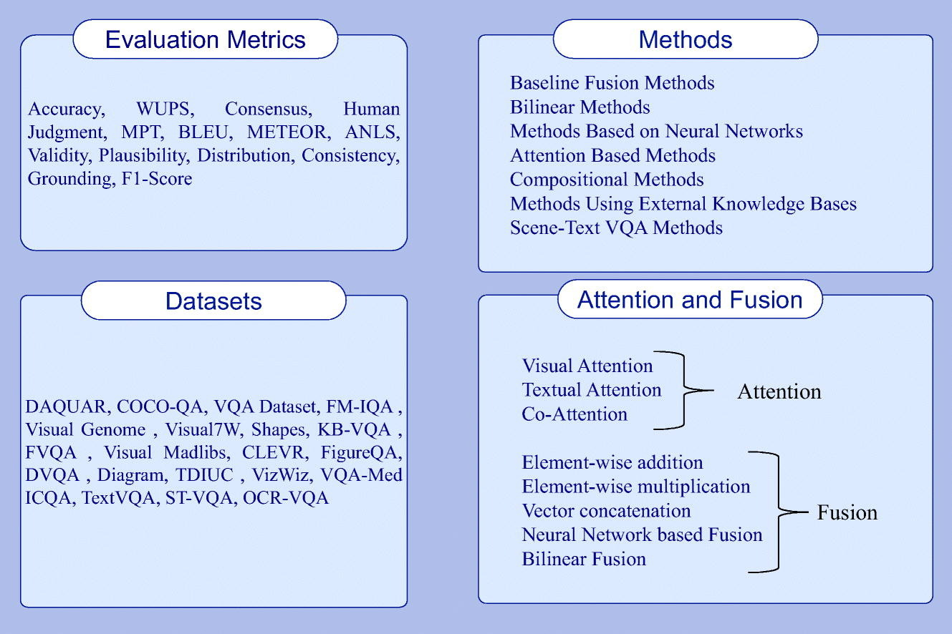
Notes:
This provides a more comprehensive overview of various aspects of QA system development:
Evaluation Metrics: A list of different metrics used to evaluate the performance of QA systems, including accuracy, BLEU, and F1-Score.
Datasets: A compilation of datasets used to train and test QA systems.
Methods: Categories of methods used in QA systems, such as neural network-based approaches and those using external knowledge bases.
Attention and Fusion: Techniques used to focus on relevant parts of input data and to combine different types of information for decision-making.

Slide 44
Relation Extraction
Answers: Databases of Relations
born-in(“Emma Goldman”, “June 27 1869”)
author-of(“Cao Xue Qin”, “Dream of the Red Chamber”)
Draw from Wikipedia infoboxes, DBpedia, FreeBase, etc.
Questions: Extracting Relations in Questions
Whose granddaughter starred in E.T.?
(acted-in ?x “E.T.”)
(granddaughter-of ?x ?y)
Notes:
This discusses relation extraction, which is a technique used to understand and identify relationships within data. It explains that:
Answers: Can be derived from databases containing predefined relationships, such as birth dates or authorship information, often sourced from structured data like Wikipedia infoboxes or knowledge bases like DBpedia.
Questions: Are processed to extract the relation implied by the query, exemplified by transforming a question into a format that can be matched against a database of relations to find the answer.

Slide 45
Temporal Reasoning
Relation databases
(and obituaries, biographical dictionaries, etc.)
IBM Watson
”In 1594 he took a job as a tax collector in Andalusia”
Candidates:
Thoreau is a bad answer (born in 1817)
Cervantes is possible (was alive in 1594)
Notes:
Temporal reasoning in question answering systems involves understanding and reasoning about time-related information within questions and candidate answers. The slide likely explains how relation databases, which might include obituaries and biographical dictionaries, can be used to cross-reference temporal data. For example, if IBM Watson receives a statement like "In 1594 he took a job as a tax collector in Andalusia," it needs to consider the historical context to filter out answers that are not temporally feasible, like suggesting Henry David Thoreau, who was born in 1817, long after 1594. On the other hand, Miguel de Cervantes could be a possible answer since he was alive during that time.

Slide 46
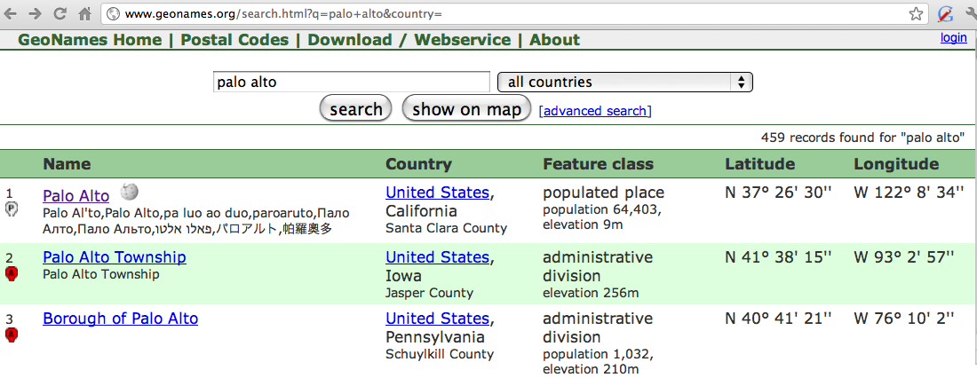
Geospatial knowledge (containment, directionality, borders)
Beijing is a good answer for ”Asian city”
California is ”southwest of Montana”
geonames.org:
Notes:
how question answering systems use geospatial knowledge to answer questions related to locations. Such systems might rely on geographical databases like geonames.org to understand and verify information about places. For instance, if a question asks for an "Asian city," Beijing would be a correct answer because it is a well-known city in Asia. Geospatial reasoning also involves understanding relative positions, as in recognizing that California is southwest of Montana. These capabilities require access to reliable geographical data sources that provide information about city locations, country boundaries, and other spatial attributes.

Slide 47
Context and Conversation in Virtual Assistants like Siri
Coreference helps resolve ambiguities
U: “Book a table at Il Fornaio at 7:00 with my mom”
U: “Also send her an email reminder”
Clarification questions:
U: “Chicago pizza”
S: “Did you mean pizza restaurants in Chicago or Chicago-style pizza?”

